Slide 1


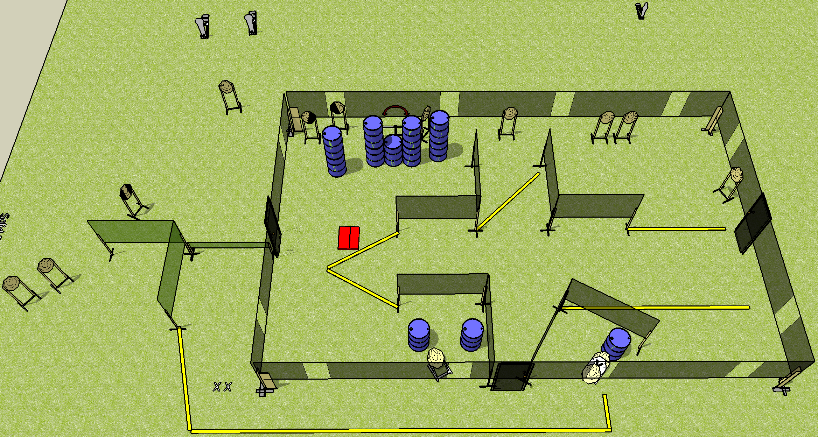
 | Dothan Gun Club – USPSA Match Home on the Range Course Designer : Drew Coleman Bay: 4
Round Count 33 rounds 15 IPSC 2 colt poppers, 1 mini
Equipment List 5 wall feet Swinger + stomp pad Low wall 1 tux, 1 left + 1 right diag

Slide 2
Home on the Range
Written Stage Briefing
Scoring: Comstock Rounds: 33 rounds
Targets: 15 IPSC, 3 Steel
Handgun start position: feet on X’s, wrists below belt. Handgun is loaded and holstered.
PCC start position: feet on X’s, stock on belt. Loaded carbine is held with both hands, safety on.
Stage Procedure: on the audible start signal, engage targets as they become available from within the shooting area.

